Slide 1

Name of the School: School of Computer Science Engineering(AI&ML)
Course Code: E1UA307C Course Name: JAVA PROGRAMMING
HOSPITAL MANAGEMENT SYSTEM
Team Members :-
Vivek Rai (23SCSE1180491)
Chandan Kumar Chaubey(23SCSE1180069)
Sitaram (23SCSE1180365)
Aman Kumar (23SCSE1180405)
Submitted to:-
Dr. Anjali Kapoor
Programme Name: B.Tech (CSE: -AI&ML)

Slide 2
Name of the School: School of Computer Science Engineering(AI&ML)
Course Code: E1UA307C Course Name: JAVA PROGRAMMING
HOSPITAL MANAGEMENT SYSTEM
INTRODUCTION:
In the proposed system, the administrator can insert, delete and modify the patient
records as per the requirements. The laboratory reports and billing details can be
easily maintained in this system. This project will help to smoother the process of the
hospital activities.
Programme Name: B.Tech (CSE: -AI&ML)

Slide 3
Name of the School: School of Computer Science Engineering(AI&ML)
Course Code: E1UA307C Course Name: JAVA PROGRAMMING
Description of the Project:
The hospital management system will enhance the patient and the hospital to serve more quickly and efficiently. This software is developed in order to digitalize the activities which takes more time, if done manually.
This system will enable the patient and hospital staff to make things faster and can get information quickly, if we want any information about patient, we can access it quickly.
Programme Name: B.Tech (CSE: -AI&ML)

Slide 4
Name of the School: School of Computer Science Engineering(AI&ML)
Course Code: E1UA307C Course Name: JAVA PROGRAMMING
OBJECTIVE OF THE PROJECT:
This main objective of the system is to digitalize the maintenance of the patient details and billing section in the hospital. It also includes the details about the laboratory checkups.
STRUCTURE OF THE PROJECT:-
Admin:-
This is the main module in the proposed project. The administrator can read
and write information about any member such as patient, doctors and staff
of the hospital. They can also update, create and delete the record of
members as requirement and implementation plan.
Programme Name: B.Tech (CSE: -AI&ML)

Slide 5
Name of the School: School of Computer Science Engineering(AI&ML)
Course Code: E1UA307C Course Name: JAVA PROGRAMMING
Patient:-
It contains details of patients who are admitted.
It contains details of the patient who came for checkups.
Lab module is used to generate laboratory reports.
The bill payment report of the patient.
FEATUCHERS OF PROJECT:-
HMS is user-friendly Hospital management software. Provides password facility for different users to ensure high level of security.
Single database management system.
It is completely user-friendly hospital management software.
It automates the patient billing process completely.
Programme Name: B.Tech (CSE: -AI&ML)

Slide 6
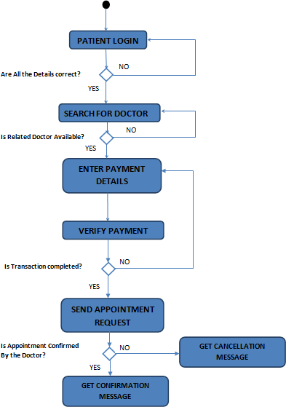
FLOW CHART
LANGUAGE AND SOFTWARE TOOL USED:-
Programming Language: Java
Database: MySQL
Frontend: Java Swing / JavaFX
Development Environment: IntelliJ IDEA / Eclipse
Version Control: Git
Operating System: Windows 10

Slide 7
Name of the School: School of Computer Science Engineering(AI&ML)
Course Code: E1UA307C Course Name: JAVA PROGRAMMING
ADVANTAGE OF PROJECT:-
Minimize handwritten work from admission to discharge & final billing.
It helps you to minimize your repeated works and take care of the complete functionality of your hospital.
It is a huge time saver and facilitates proper communication among the management, staff, and the patient parties.
Changes are always difficult for any human being. HMS will help you a lot for easy changes from manual to computerized one.
Programme Name: B.Tech (CSE: -AI&ML)

Slide 8
Name of the School: School of Computer Science Engineering(AI&ML)
Course Code: E1UA307C Course Name: JAVA PROGRAMMING
FUTURE SCOPE OF THE PROJECT:-
This project will enhance the patients and the hospital to serve more quickly and efficiently. This software is developed in order to computerize the activities which take more time, if done manually.
Hospital billing system will enable the patient and hospital staff to make things faster and can get information quickly. If we want any information about patient, we can access it quickly.
Programme Name: B.Tech (CSE: -AI&ML)

Slide 9
Name of the School: School of Computer Science Engineering(AI&ML)
Course Code: E1UA307C Course Name: JAVA PROGRAMMING
Programme Name: B.Tech (CSE: -AI&ML)

